Slide 1
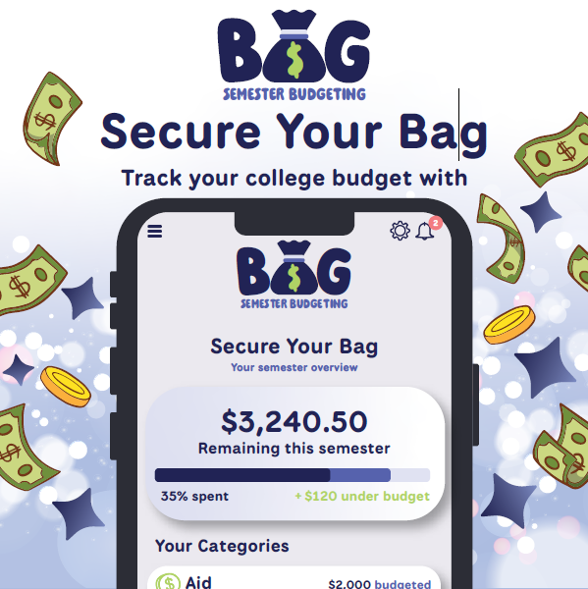
We all fund our education differently — but we all face the same semester.
Bills don't pause. Tuition doesn't shrink.
Money runs out no matter what situation you're in.
A Semester-Based Financial Survival System for College Students
Mattea • Loffert • Paul • Joey
Secure Your Bag. Own Your Independence.
Notes:
MATTEAS SLIDE

Slide 2
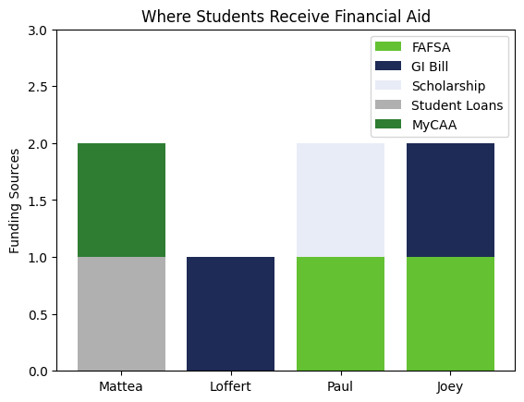
Four Students, Four Funding Systems
Our Real Funding Situations
Mattea
MyCAA + Student Loans
Loffert
Chapter 33 GI Bill (Dependent Transfer)
Paul
FAFSA + Scholarship
Joey
FAFSA + Montgomery GI Bill
Different funding systems.
Same 16-week semester.
Same risk of running out.
Notes:
Everyone Collab Slide
Change to graph of where students get different financial aid (anecdotes of what we use are spoken only)

Slide 3
The Common Problem
The Semester Trap
Aid arrives in a lump sum
Expenses happen weekly
The semester lasts 16 weeks
Overspending early = stress later
“The problem isn’t the amount.
It’s the timing.”
Notes:
JOEYS SLIDE
“Financial aid usually comes in one big deposit at the beginning of the semester. And when that money hits, it feels like a lot.
But the semester doesn’t move in one big payment — it moves week by week.
Rent is monthly. Groceries are weekly. Textbooks hit immediately. And the semester lasts 16 weeks.
“How many of you actually know — right now — whether you’re going to make it financially to the end of this semester or school year?”
Pause. Look around.
“Exactly. Most of us don’t.”
The issue isn’t that students don’t receive money.
It’s that the timing doesn’t match how real life expenses happen.
No matter how we’re funded — MyCAA, the GI Bill, scholarships, FAFSA — the semester moves weekly.
Our money doesn’t.”
Pause.
Transition.

Slide 4

Why Current Apps Fail
Traditional Budget Apps Don’t Think in Semesters
Built around monthly budgeting
Assume consistent income
No academic calendar awareness
No pacing comparison
“They show what you spent — not whether you’ll make it to finals.”
Notes:
PAULS SLIDE (1MIN)

Slide 5
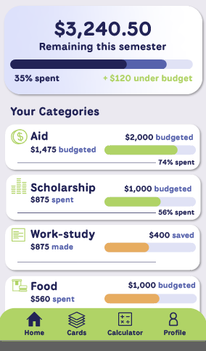
How can Bag help?
Built for Semester Life
Bag can show you:
Organized spending categories
Amount of semester complete % of funds used
Divide up your finances across your semester to show you what’s “safe to spend” per week, and pace your income in a digestible visual format
Notes:
LOFFERTS SLIDE

Slide 6

Supportive Alerts
Supportive
Not judgmental
Built for independence
Optional parent notification system
Teaching Moments:
“You’ve used 35% of your semester funds — we’re only at week 4.”
“Housing allowance is on track.”
“You’re pacing well this week.”
Notes:
MATTEAS SLIDE
Move the triangle possibly to center photo

Slide 7
Parental Viewing - Visibility on Your Terms
Viewers cannot:
See purchases
Change or restrict budgets
Control spending
Viewers can see:
Overall progress
Category totals
“Transparency without control.”
Notes:
LOFFERTS SLIDE

Slide 8
What it feels like to use the app
From week 1 to finals
Week 1:
Clear weekly allowance. How did that help you?
Week 5:
Alerts Triggers – adjust spending
Week 12:
Still on track
Week 16:
No panic
“Bag doesn’t just track money — it helps it last.”
Notes:
PAULS SLIDE

Slide 9

Why Bag?
There is no “average” student.
Different funding. Different pressures. Same 16-week semester.
College is the first time many of us manage money alone.
You don’t need more stress. You need clarity.
Secure Your Bag. Own Your Independence.
Notes:
JOEYS SLIDE
“When we started this project, we thought we were building an app.
But what we realized… is that this isn’t just about budgeting.
It’s about independence.
College is the first time many of us manage money on our own. The first time we make financial decisions without someone standing behind us.
And that’s stressful.”
(Pause.)
“Quick show of hands — How many of you have ever worried about running out of money before the semester ended?”
Raise your hand. Wait 2–3 seconds. Look around.
“That’s exactly why Bag exists.
We didn’t build this because students need another finance app.
We built it because students need clarity.
Different funding. Different backgrounds. Same semester.
Bag isn’t about control.
It’s about confidence.
Secure your bag.
Own your independence.”
Pause.
Smile. Step back slightly.
End.

